Slide 1

FPGA-based Implementation of a Tree-based Classifier using HW-SW Co-design.
Research Paper Presentation
on
School of Engineering and Sciences (SEAS)
Department of Electronics and Communication Engineering
SRM University, Andhra Pradesh (SRM AP)
Presented by
Jagadeesh_(AP2312210002)
M.Tech _ IOT Student

Slide 2
Outline
Introduction
Abstract
Literature Review
Objectives
Methodology
Research gap
Paper Case Study
Steps in Design Process
Techniques and Software Tools
Conclusion and Future scope
Referred Paper
DESSION TREE CLASSIFICATION
IMPLEMENTATION APPROACHES
PROPOSED IMPLEMENTATION
EXPERIMENTAL WORK

Slide 3
Introduction
FPGA: hardware for machine learning
FPGA advantages: parallel, real-time, efficient
Research motivation: co-design for tree classifier
Research need: efficient and optimized solutions
Research overview: objectives, methods, components
Hardware challenges: limitations of existing approaches
Proposed approach: benefits of software-hardware integration
Presentation structure: sections and insights

Slide 4
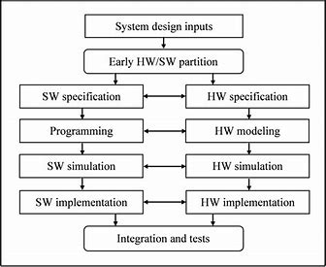
Abstract
FPGA enables parallel processing for classification tasks
Hardware structure format poses challenges for classifier components
Hardware-software co-design approach proposed to optimize tree-based classifier
ID3 algorithm used for the classifier implementation

Slide 5
Literature Review
Literature Review:
Purpose: Explore existing research on FPGA-based classifier implementations.
Objective: Understand the landscape and identify gaps.
Research on FPGA-Based Implementations:
Summarize studies and papers exploring FPGA-based machine learning classifiers.
Highlight diverse methodologies and approaches used.
Advantages of FPGA in Machine Learning:
Parallel processing capabilities.
Real-time data processing.
Efficiency gains.
Existing Approaches in Literature:
Hardware-only designs.
Software-only designs.
Challenges and Limitations:
Area overhead.
Power consumption.
Technology dependencies.
Comparison of Approaches:
Analyze strengths and weaknesses.
Consider scalability and reusability.
Relevant Studies and Findings:
Summarize studies related to hardware-software co-design for tree classifiers.
Discuss outcomes in the context of FPGA implementations.
Significance of Proposed Approach:
Address limitations from existing literature.
Emphasize benefits of software-hardware integration.

Slide 6
Objective
Research Objectives
Propose a hardware-software co-design approach.
Optimize tree-based classifiers using FPGA.
Existing Approaches in Literature
Hardware-only designs.
Software-only designs.
Challenges and Limitations
Area overhead.
Power consumption, Technology dependencies.
Comparison of Approaches
Analyze strengths and weaknesses.
Consider scalability and reusability.
Relevant Studies and Findings
Summarize studies related to hardware-software co-design for tree classifiers.
Discuss outcomes in the context of FPGA implementations.
Significance of Proposed Approach
Address limitations from existing literature.
Emphasize benefits of software-hardware integration.

Slide 7

Methodology
Research Design
Objective: Develop a hardware-software co-design approach for implementing a tree-
Rationale: Address limitations of existing FPGA implementations.
Hardware Components
FPGA Platform: Utilize platforms like Xilinx Vertix-5.
Micro-blaze Processor: Core component for executing software functions.
Additional Modules: Include pre-processing and feature engineering units.
Software Components
ID3 Algorithm Functions: Executed on the Micro-blaze processor.
Software Cores: Run on FPGA for dataset pre-processing and metric evaluation.
Integration of Hardware and Software
Cohesive System: Combine hardware and software elements.
Communication Protocols: Define data exchange between components.
Data Flow: Ensure seamless interaction.
Implementation Steps
Micro-blaze Configuration: Set up the soft-core processor.
Dataset Pre-processing Unit: Integrate for data preparation.
Metric Evaluation Units: Incorporate for performance assessment.
Tree-Construction Unit: Implement the ID3 algorithm.
Testing and Validation
Functional Testing: Validate classifier functionality.
Performance Evaluation: Assess latency, area overhead, and power consumption.
Comparison with Existing Approaches
Advantages: Highlight improvements over other FPGA-based classifiers.
Innovative Aspects: Emphasize benefits of your co-design approach.
based classifier.

Slide 8
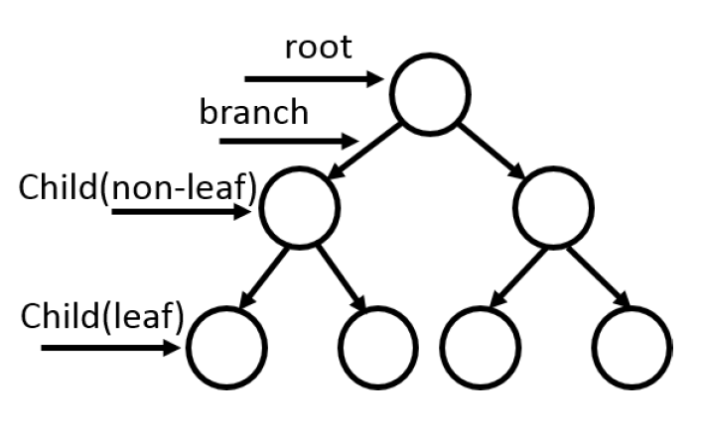
Decision Tree Classification
Definition and Structure:
Decision tree classification: Constructing a tree from labeled training data (supervised learning).
Tree components: Root node, children nodes, branches (test outcomes), leaf nodes (class labels).
Algorithms and Metrics:
Algorithm selection: Attributes at each node split the dataset.
Evaluation metrics: Gini index, information gain (entropy-based).
Examples of Decision Tree Algorithms:
ID3, C4.5, CART, CHAID, MARS.
Implementation Approaches:
Software-Based Tools: Utilize existing software libraries.
Hardware Design: Structural implementation with modules.
Hardware-Software Co-Design: Concurrency, recursive functions.
Hybrid Classification Engineering:
Combine CPU and FPGA shared memory.
Address limitations of on-chip FPGA memory for large ensembles and deep trees.
Challenges and Research Gaps:
Lack of FPGA design details hinders replication and understanding.
Missing performance evaluation (latency, area overhead, power consumption).

Slide 9
IMPLEMENTATION APPROACHES
Software-Based Tools
Hardware Design
Hardware-Software Co-Design
Hybrid Classification Engine
Performance Evaluation

Slide 10
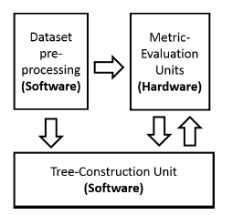
PROPOSED IMPLEMENTATION
Hardware-Software Co-Design:
Address latency vs. area & power trade-off.
Combine hardware concurrency with software flexibility.
Micro-blaze Processor:
Xilinx Micro-blaze IP core as the main processor.
Configured using Xilinx tools and wrapped in VHDL code.
Block Diagram:
Three main blocks: dataset pre-processing, metric evaluation, tree construction.
Software core for dataset handling.
Metric Evaluation Unit:
Parallel information gain qualifiers.
Calculate entropy and information gain.
Input for tree construction.
Testing and Validation:
Validate functionality and performance.
Evaluate latency, area, and power.
Advantages of Proposed Implementation:
Optimized performance and modularity.
Efficient execution of complex ML algorithms on FPGA.

Slide 11
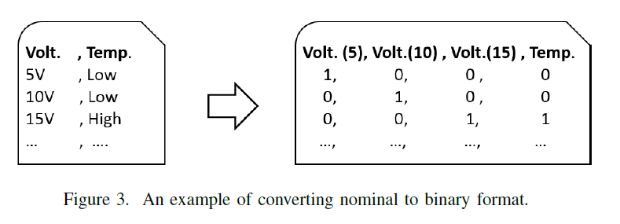
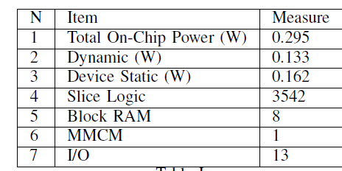
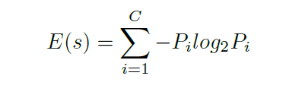
EXPERIMENTAL WORK
Pre-Processing:
Convert attribute values to boolean format.
Facilitate input for the hardware classifier.
Ensure machine-friendly binary representation.
Decision Trees Construction:
Root element selection based on information gain.
Recursive generation of child nodes.
Top-down tree building for class prediction.
Experimental Setup:
Test proposed implementation on FPGA.
Evaluate performance metrics:
Static and dynamic power consumption.
Latency.
Area overhead.
Dataset Processing:
Read dataset file.
Convert nominal to numeric values.
Normalize dataset for decision tree input.
Performance Evaluation:
Assess decision tree classifier efficiency.
Metrics: Power consumption, speed, resource utilization.
Validation of Results:
Experimental results validate design effectiveness.
Evaluate power efficiency, accuracy, and speed.
Practical Applications:
Demonstrate suitability for real-world use.
Manage power consumption within acceptable limits.

Slide 12
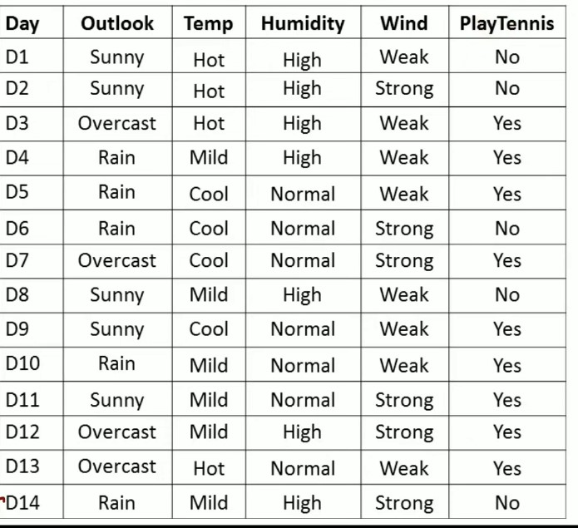

Slide 13
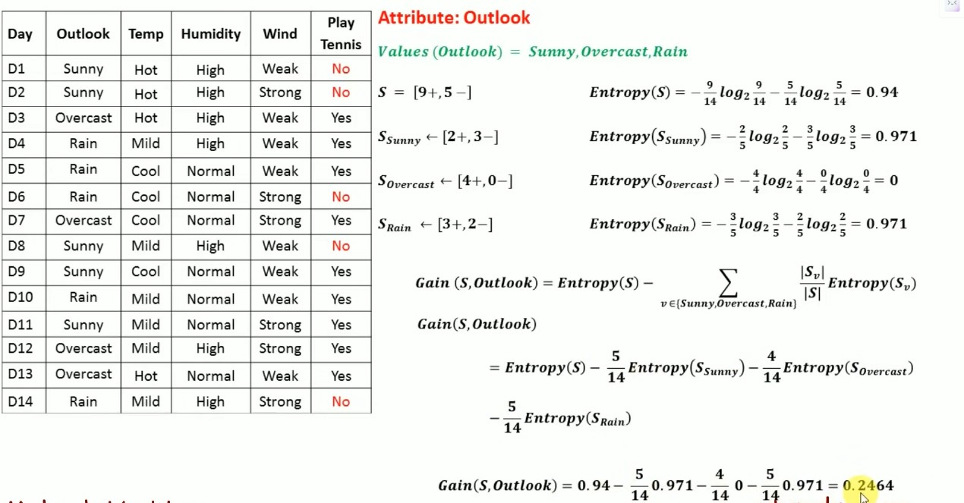

Slide 14
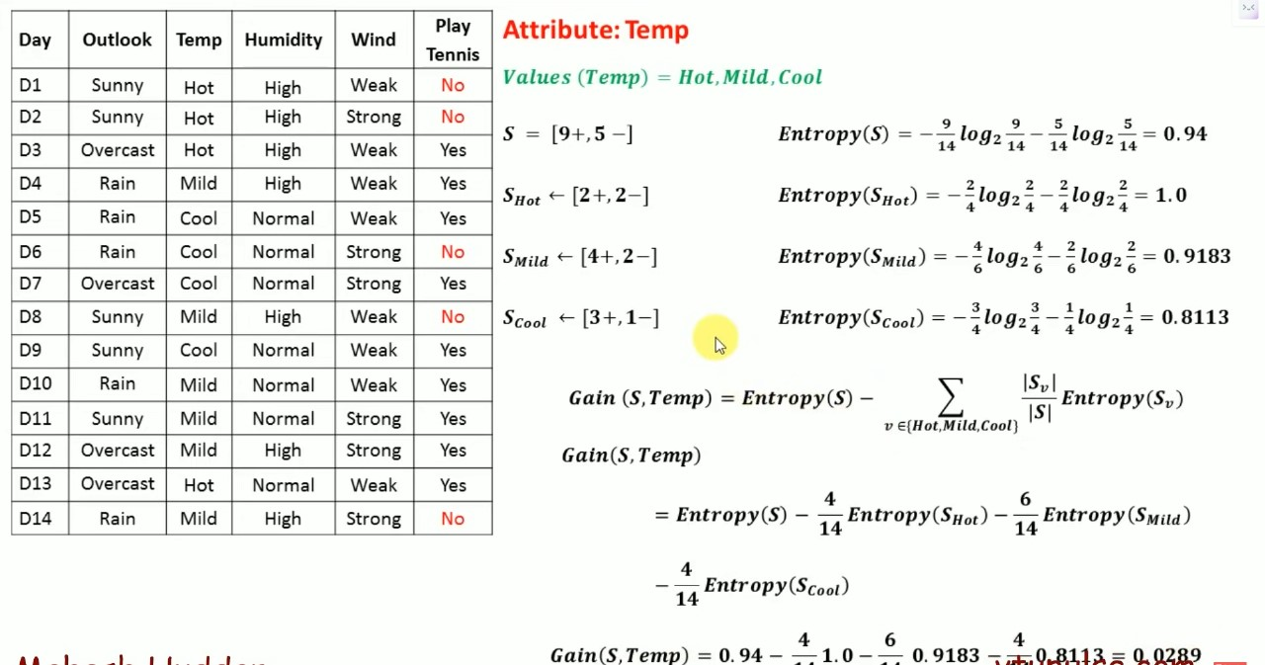

Slide 15
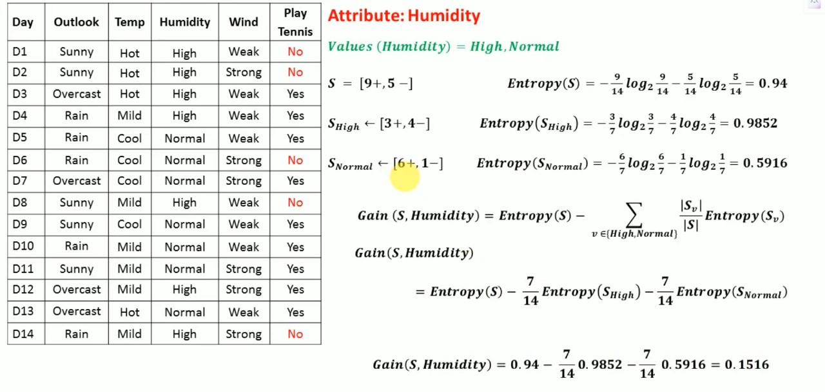

Slide 16
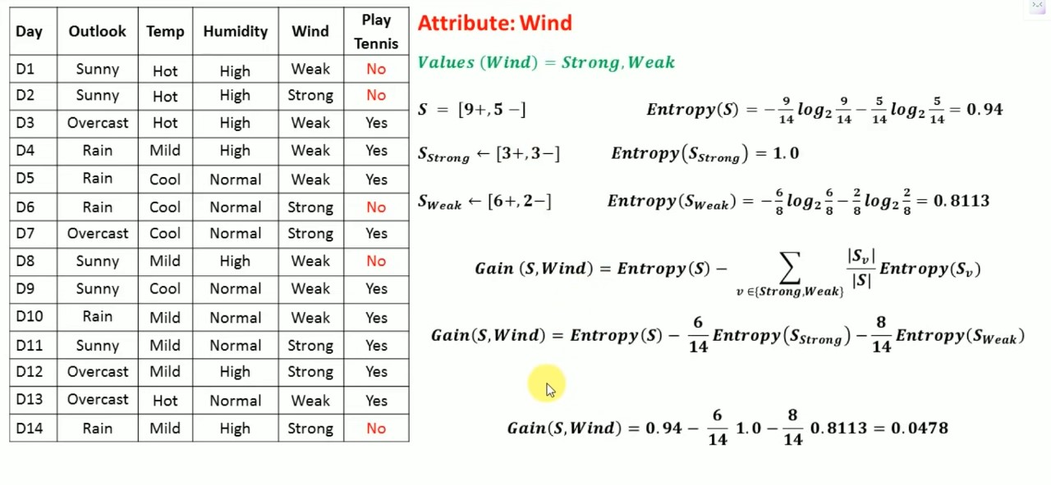

Slide 17
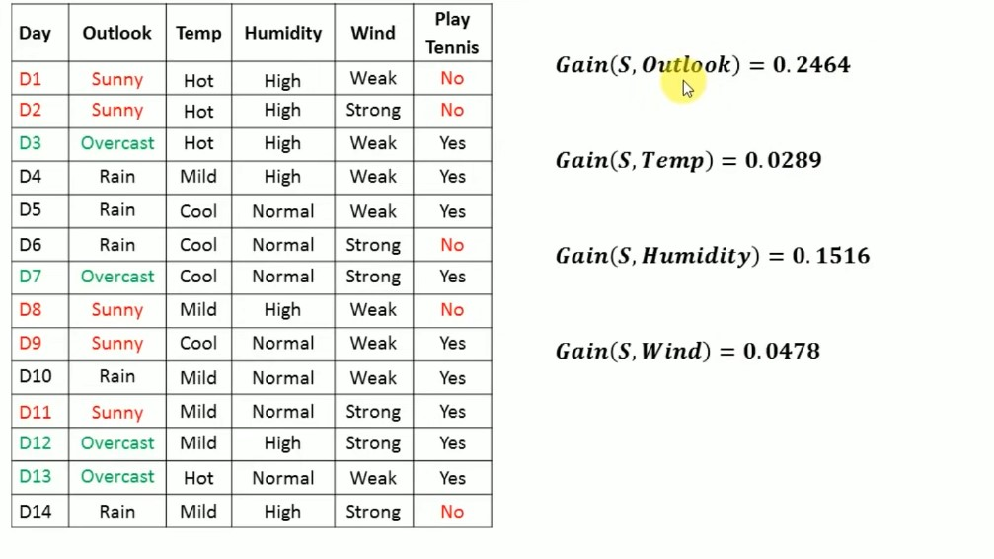

Slide 18
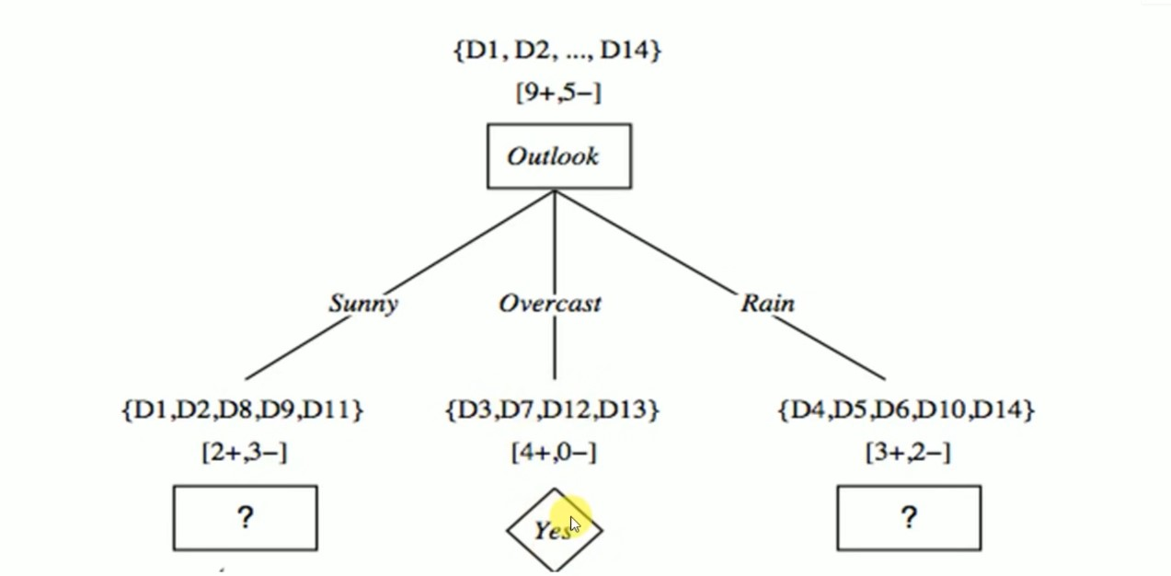

Slide 19
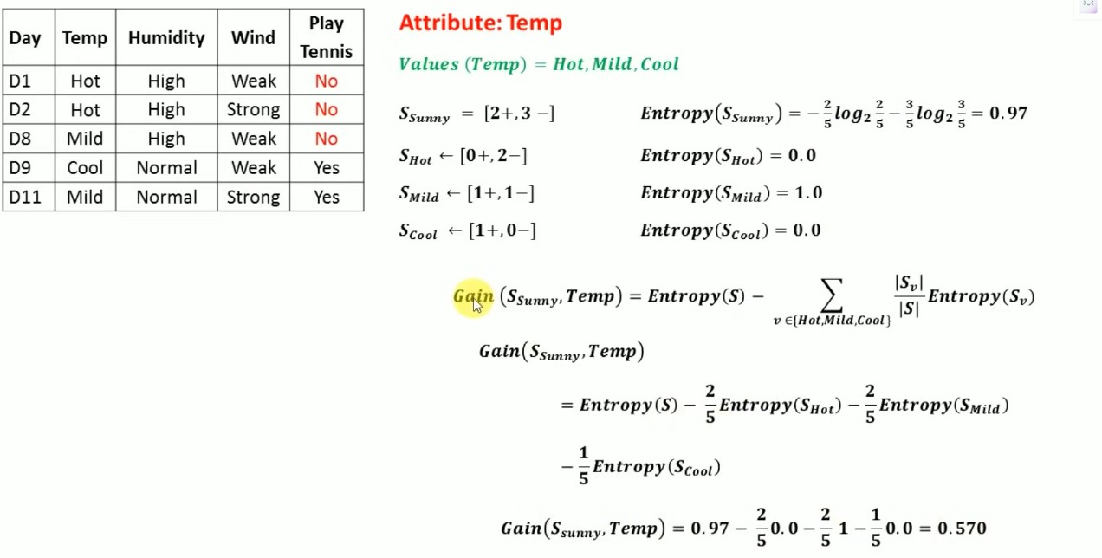

Slide 20
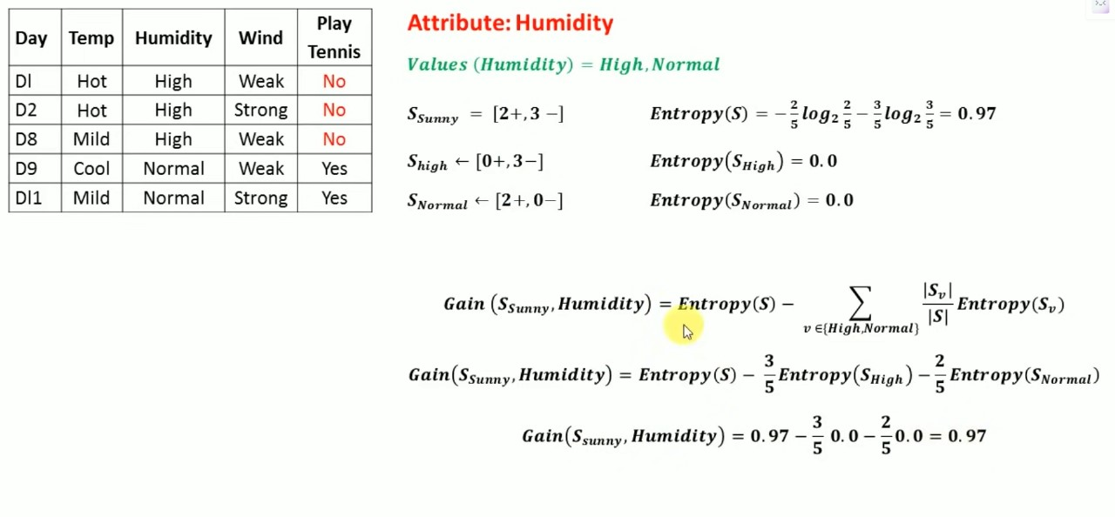

Slide 21
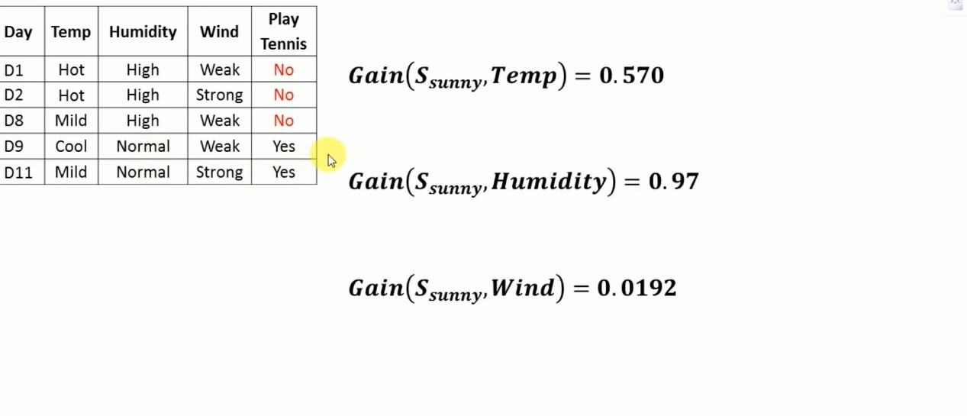

Slide 22
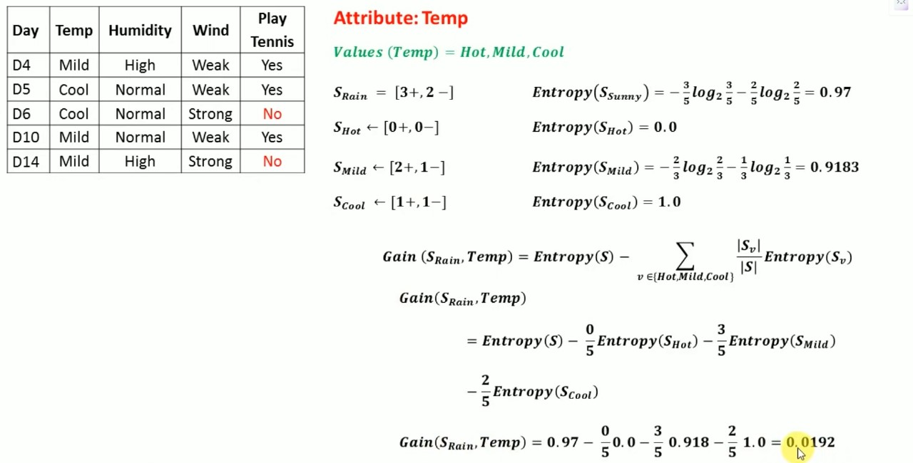

Slide 23
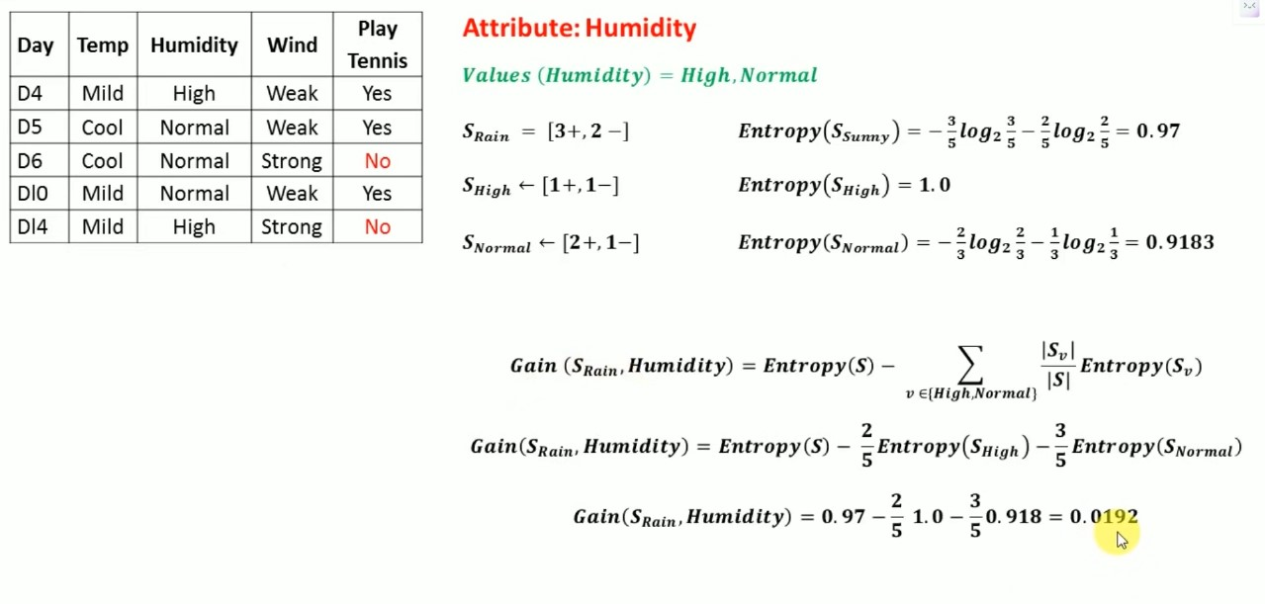

Slide 24
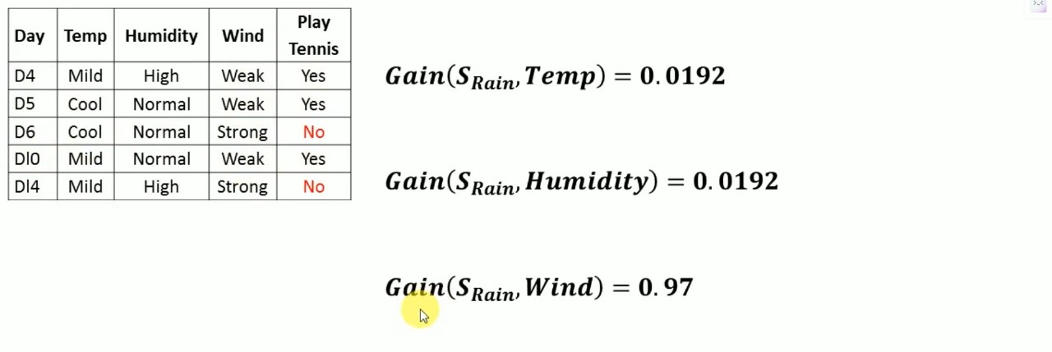

Slide 25
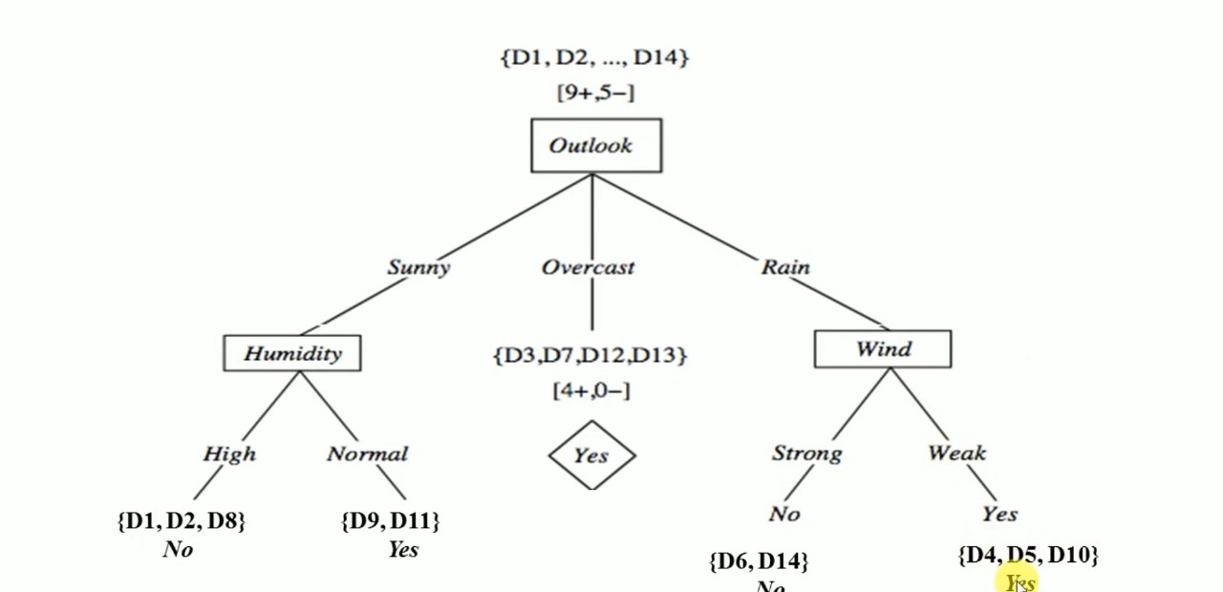

Slide 26
Steps in Design Process
Problem Definition and Requirements Analysis
Literature Review and Research Study
Selection of Tools and Technologies
System Architecture Design
Software Module Development
Integration and Co-Design
Verification and Testing
Hardware Module Design
Optimization and Performance Tuning
Validation and Evaluation

Slide 27
Tools and Software’s
Xilinx Vivado: Vivado was likely used for synthesizing the hardware components of the tree-
based classifier and integrating them into the FPGA platform.
Xilinx MicroBlaze Processor: The MicroBlaze soft-core processor from Xilinx was employed in the FPGA
design to execute the ID3 algorithm functions 1.
This processor core is configurable and can be customized to suit the specific requirements of the
machine learning tasks.
Hardware Description Languages (Verilog/VHDL): These languages were likely utilized to describe the behavior of individual
hardware modules within the tree-based classifier.
High-Level Synthesis (HLS) Tools: While HLS tools may have limitations in synthesizing recursive functions, they can still be
valuable for accelerating the design process.
Dataset Processing Tools: Tools for dataset pre-processing, normalization, and feature engineering were likely used to prepare
the input data for the decision tree classifier 3.
Simulation and Verification Tools: Simulation tools such as Model Sim may have been used for verifying the functionality and
performance of the FPGA-based implementation 1.

Slide 28
Conclusion
Integration with Advanced Technologies:
Enhance capabilities by integrating with deep learning frameworks or edge computing platforms.
Explore compatibility with newer FPGA architectures and tools.
Validation and Benchmarking:
Conduct thorough validation studies.
Compare against existing solutions to assess competitiveness and uniqueness.
Optimization and Performance Enhancement:
Further optimize the design to improve latency and resource utilization.
Explore advanced algorithms for more efficient decision tree construction.
Scalability and Versatility:
Extend the system to handle larger datasets and complex tree structures.
Investigate scalability for diverse machine learning tasks and algorithms.

Slide 29
Referred Paper
Title - FPGA-based Implementation of a Tree-based Classifier using HW-SW Co-design
Authors
Published in: 2019 6th International Conference on Advanced Control Circuits and Systems (ACCS) & 2019 5th International Conference on New Paradigms in Electronics & information Technology (PEIT)
Date of Conference: 17-20 November 2019
Date Added to IEEE Xplore: 13 April 2020
ISSN Information: Electronic ISBN:978-1-7281-6354-3
Ratshih Sayed
Microelectronics Department, Electronics Research Institute, Cairo, Egypt
Haytham Azmi
Microelectronics Department, Electronics Research Institute, Cairo, Egypt
CD:978-1-7281-6352-9
DOI: 10.1109/ACCS-PEIT48329.2019.9062867
Publisher: IEEE
Conference Location: Hurgada, Egypt

Slide 30
Thank You

